Slide 1
Asynchronous Programming

Slide 2
What is Asynchronous programming ?
Asynchronous programming is a means a unit of work, runs separately from the main application thread and notifies the calling thread of its completion, failure or progress.

Slide 3
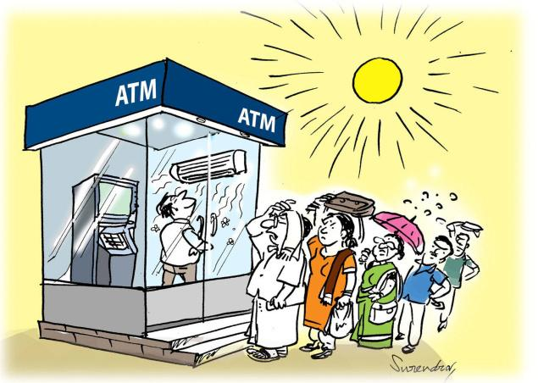

Synchronous Vs Asynchronous

Slide 4

Asynchronous Vs Parallel
Boiling egg scenario

Slide 5
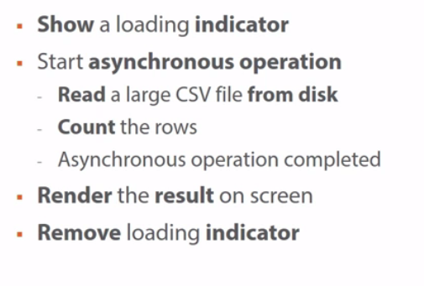
Asynchronous Programming Example

